Slide 1
Navigation Reimagined: ATOM - The Future of Accessible Wayfinding is Here
Tinski Tech Inc. Presents:
ATOM

Slide 2
Assistive Technology for Orientation and Mobility (ATOM) Executive Summary
ATOM's groundbreaking assistive technologies enable unprecedented accessibility and wayfinding for the blind and visually impaired, allowing businesses to profitably serve the mobility needs of millions in untapped markets.

Slide 3
Expanding Access: Addressing an Overlooked Need
Vision impairment impacted over 10 million Americans in 2020, with cases expected to double by 2050 driven by aging demographics and eye diseases.
Mainstream mobility aids like white canes and guide dogs have severe limitations safely navigating crowded indoor spaces like offices, clinics, schools.
61% of legally blind adults report inability to travel outside unaccompanied, facing isolation and unemployment risks from orientation challenges.
Lack of environmental awareness and inability to dynamically detect hazards leads to disorientation, anxiety and accidents for the visually impaired.
Advanced Assistive Technologies that enhance spatial understanding, provide proximity alerts and give audio pathing assistance can greatly improve confidence, access and participation for millions mobility-impaired.

Slide 4
Introducing ATOM: Reimagining Navigation for the Vision Impaired
ATOM enables next-generation accessible mobility via:
Detailed Spatial Mapping
Dynamic Hazard Alerts
Natural Audio Guidance
Cloud-free Operation
Blending discreet on-body guidance devices with assistive spatial infrastructure temporarily mapping spaces, ATOM supports accessible navigation via responsively generated audio prompts benefitting from local environmental insights..

Slide 5
ATOM Key Capabilities:
Localized Situational Mapping. Chaperone's exclusively onboard camera sensors temporarily capture occupancy data to construct specialized spatial maps attuned to Users, devoid of external sharing.
Dynamic Hazard Detection Proprietary machine learning algorithms analyze user patterns to provide real-time collision alerts customized to pace and responsiveness.
Natural Guidance Interface
ATOM generates location-based audio prompts shaped to user positioning for intuitive mobility while reducing sensory burden.
Secure Edge Connectivity Dedicated local routers enable information exchange solely between on-premise ATOM modules to guarantee operational privacy by design.
By synergizing best-in-class ML, UX and rapidly evolving IoT platforms tailor-made for accessibility, ATOM delivers revolutionary, discreet support for confident navigation.

Slide 6
What's in it for location owners?
What Location Owners Get With ATOM Business:
Expanded Customer Base: Serve millions of visually impaired customers needing advanced wayfinding assistance - an overlooked demographic
Competitive Edge: Gain an advantage over other establishments by being accessible and inclusive
Enhanced Reputation: Demonstrate commitment to serving all customers and compliance with ADA regulations
New Revenue Stream: Attract new visually impaired customers representing potential untapped revenue
Turnkey Solution: ATOM handles mapping, alerts and audio guidance - no expertise needed for business owners
What Owners Need to Do:
Purchase ATOM service package based on building size
Grant access for initial spatial mapping walkthrough
Provide power connections for installed assistive beacons
Promote establishment's accessibility to expand reach
That's it! ATOM handles the rest - spatial mapping, dynamic hazard alerts and natural audio guidance for visually impaired patrons.

Slide 7
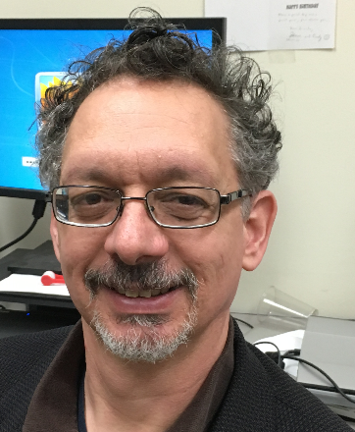
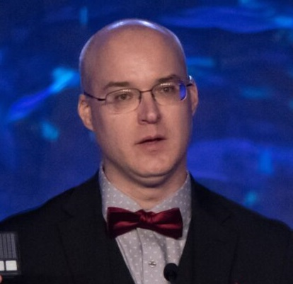
Key Personnel Behind ATOM
Martin Goldberg, CEO - Tinski Tech
PhD Computer Science;
15+ years software engineering.
Pioneer in mobile spatial computing for accessibility.
Visionary behind ATOM.
Clarke Thrasher
Marketing Lead - Tinski Tech Soon-to-be MBA grad with demonstrated excellence in positioning and pitching innovations.
Tim Oates
Lead Architect - Synaptiq
Professor of Computer Science at UMBC.
Specializes in machine learning, computer vision and human-centered AI systems.
Dave Schleppenbach
Chief Business Advisor - Tactile Engineering Serial assistive technology entrepreneur.
Expertise in advanced manufacturing techniques and STEM education for the visually impaired.

Slide 8
Large, High-Growth Assistive Technology Market
Visually Impaired Population (2020)
10M+ Americans
200M+ Globally
Key Growth Drivers
Aging demographics
Increased eye disease prevalence
Lack of curative solutions
Market Projections
Global Assistive Tech for Visually Impaired market to reach $9.5B by 2028
~13% CAGR
Increasing insurance coverage & tech adoption expanding access

Slide 9
Competitive Analysis
 | Blind Square | AIRA | Be My Eyes | WeWalk | Indoor Atlas
Ease of Use (1 –5 5- hard) | 4 | 3 | 4 | 5 | 5 | 1
Cost (1-3; 3 - High) | 2 | 3 | 1 | 3 | 3 | 1
Latency Issues | Yes | Yes | Yes | Yes | Unknown | No
GPS & Cloud reliance | Yes | Yes | Yes | Yes | Unknown | No
Direction | Yes | Yes | Yes | Unknown | No | Yes
Wayfinding | No | Partial | Partial | Yes | No | Yes
Safety | Maybe | Maybe | Maybe | Yes | No | Yes
Security | No | No | No | No | No | Yes
Interactive with Environment | No | No | No | No | No | Yes

Slide 10
ATOM Business: Driving Revenue Through Managed Infrastructure
Seeking Advocacy Partners
Align with our accessibility mission
Help inform product refinements
Pursuing Technology Collaboration
Integration to boost adaptability
Co-marketing to expand reach
Interested in Investing?
Exponential assistive tech growth potential
Proven founder-market fit team
Next Steps:
Set up a meeting
Further conversations
Work together towards positive impact

Slide 11
ATOM's Financial Growth Trajectory
 | Revenue | Expenses | Profitability
Year 1 | $0 | $250K | Initial Research Period
Year 2 | $1.2M | $850K
Year 3 | $4.5M | $2.1M | Break Even
Year 4 | $10.2M | $4.2M | 25% margin
Funding Needs
Seeking $500K seed round
$2M Series A in Year 3
Core Metrics
High margin SaaS business
Capital efficient growth

Slide 12
Join Us in Enhancing Accessibility
Seeking Advocacy Partners
Align with our accessibility mission
Help inform product refinements
Pursuing Technology Collaboration
Integration to boost adaptability
Co-marketing to expand reach
Interested in Investing?
Exponential assistive tech growth potential
Proven founder-market fit team
Next Steps:
Set up a meeting
Further conversations
Work together towards positive impact

